Slide 1

OLIST STORE ANALYSIS
Domain : E-Commerce
Presented By:
Tushar Arun Chaudhari
Shreja C Alex
Shubha Verma
Ritesh Kumar Sinha
Divya Rastogi
Jeevan URS M

Slide 2
OBJECTIVE:
Strategic Insight: Extract actionable insights from extensive e-commerce datasets to understand customer behaviors, preferences, and market trends.
Optimized Marketing: Identify peak transaction periods, popular product categories, and customer preferences to refine marketing strategies and campaigns.
Operational Efficiency: Analyze order delivery timelines and customer reviews to enhance operational processes, improve customer satisfaction, and ensure timely deliveries.
Data-Driven Decisions: Equip stakeholders with data-driven visuals and analyses for informed decision-making, ensuring alignment with market demands and customer needs.
Multi-Tool Proficiency: Showcase proficiency in diverse data analysis and visualization tools, ensuring a holistic and comprehensive analytical approach.

Slide 3
PROCESS:
Data Acquisition and Understanding: Procure and familiarize with the dataset spanning across 9 diverse CSV files.
Data Cleaning and Transformation: Engage in a thorough process of data cleansing, removing anomalies, and transforming data into a suitable format for analysis.
Data Analysis: Dive deep into the dataset to extract insights, patterns, and relationships amongst different data elements.
Visual Representation: Create compelling visuals to represent key performance indicators (KPIs) using a suite of tools:
Excel
MySQL
Power BI
Tableau
5) Comprehensive Understanding: Utilize the above tools not just for visualization, but to gain a holistic understanding of the data and derive actionable insights.

Slide 4
KEY PERFORMANCE INDICATORS(KPI)
1. WEEKDAY VS WEEKEND PAYMENT STATISTICS:
This metric contrasts the payment behaviors of customers during weekdays versus weekends.
It leverages the order_purchase_timestamp to discern which purchases happened on which days.
To identify if there's a significant variation in customer spending behavior based on the day of the week.
To optimize sales strategies and promotions based on high transaction days

Slide 5
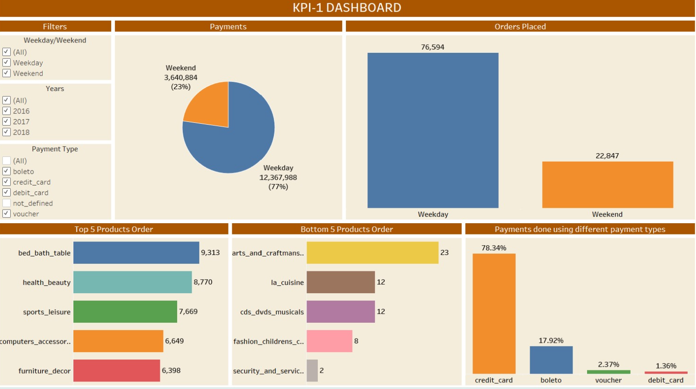

Slide 6
KEY PERFORMANCE INDICATORS(KPI)
NUMBER OF ORDERS WITH REVIEW SCORE 5 AND PAYMENT TYPE AS CREDIT CARD:
Understand the correlation between high customer satisfaction (review score of 5) and the preferred payment mode (credit card).
Evaluate if customers paying with credit cards are more satisfied with their purchases compared to users of other payment modes.
Assess the significance of credit card transactions in high-rated orders.
Determine if there are specific characteristics or patterns among credit card users that influence their satisfaction.
Use insights to enhance customer experience and encourage a higher number of top-rated reviews.

Slide 7
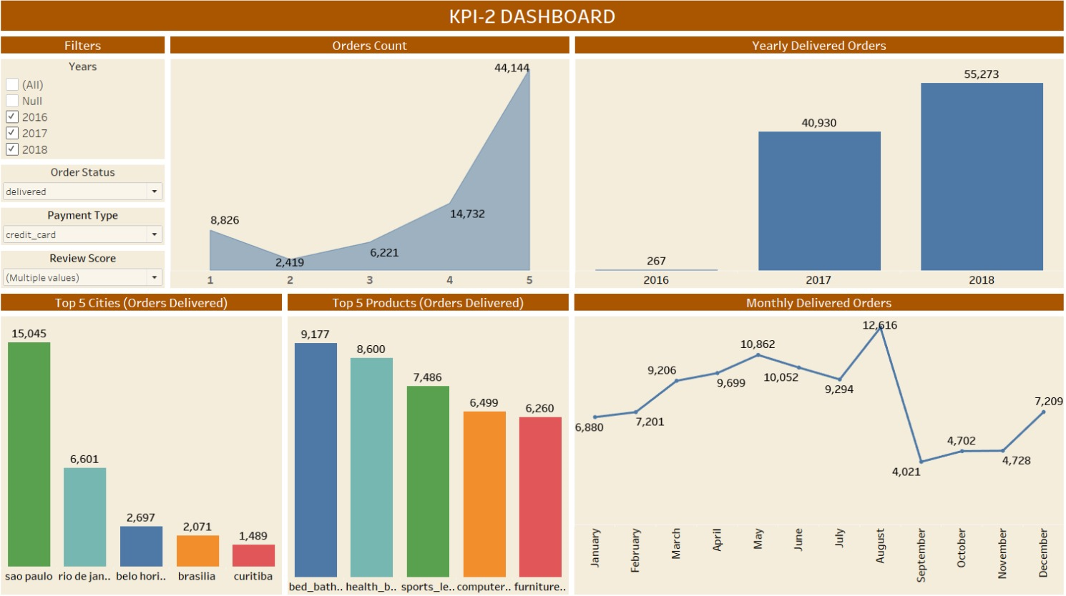

Slide 8
KEY PERFORMANCE INDICATORS(KPI)
3. AVERAGE NUMBER OF DAYS TAKEN FOR ORDER_DELIVERED_CUSTOMER_DATE FOR PET_SHOP:
Evaluate the efficiency and speed of the delivery process specifically for pet shop items.
Understand if pet shop products have unique shipping constraints or challenges leading to delays.
Compare the delivery timeframe for pet shop items against other product categories to identify any discrepancies.
Assess if the delivery speed for pet shop products meets customer expectations and industry benchmarks.
Use insights to optimize the supply chain process and ensure timely delivery for pet shop customers.

Slide 9
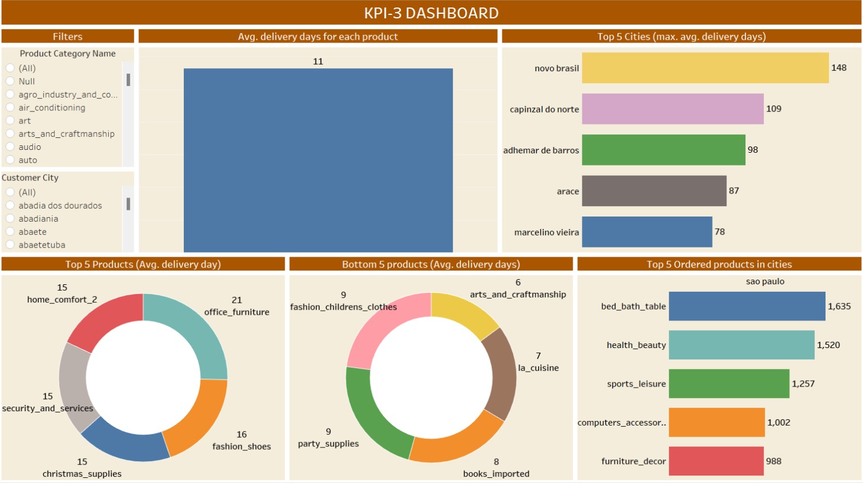

Slide 10
KEY PERFORMANCE INDICATORS(KPI)
4. KPI: AVERAGE PRICE AND PAYMENT VALUES FROM CUSTOMERS OF SAO PAULO CITY:
Examine the purchasing power and spending patterns of customers residing in Sao Paulo city.
Identify if Sao Paulo, being a major city, has a significant influence on the overall revenue generated.
Understand if certain promotions or products are more popular in Sao Paulo compared to other regions.
Evaluate the effectiveness of marketing strategies targeted towards the Sao Paulo demographic.
Utilize the insights to tailor future promotions and sales strategies specific to the Sao Paulo audience to maximize profits.

Slide 11
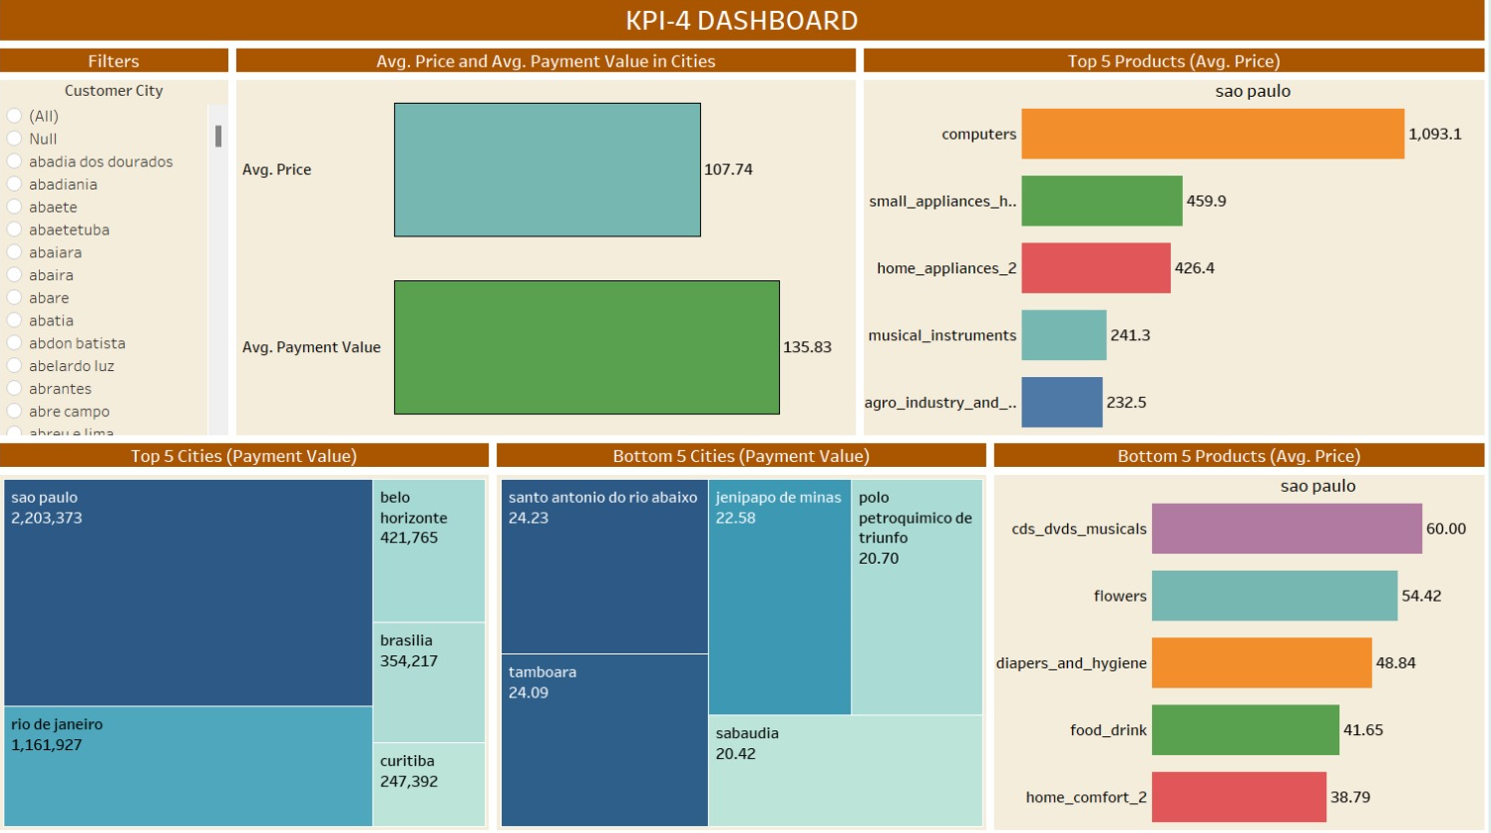

Slide 12
Key Performance Indicators(KPI)
RELATIONSHIP BETWEEN SHIPPING DAYS AND REVIEW SCORES:
Evaluate how shipping duration affects customer satisfaction as reflected in the review scores.
Determine if there's a threshold in shipping days after which customer satisfaction drops significantly.
Understand the impact of delivery speed on overall customer experience and satisfaction.
Identify areas of improvement in the supply chain to enhance customer reviews.
Use insights to set benchmarks for shipping duration which, when maintained, can result in consistently high review scores.

Slide 13
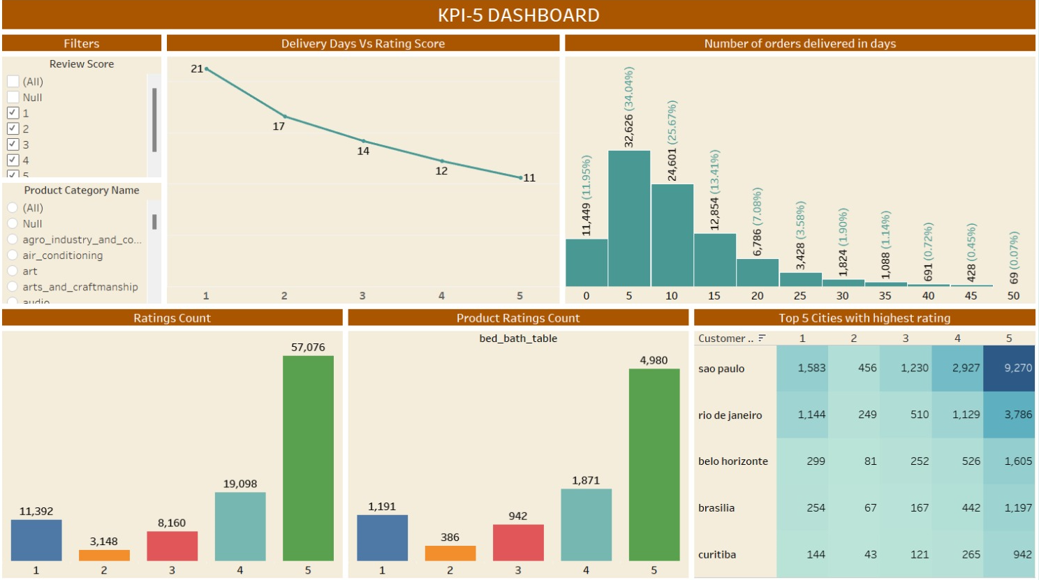

Slide 14
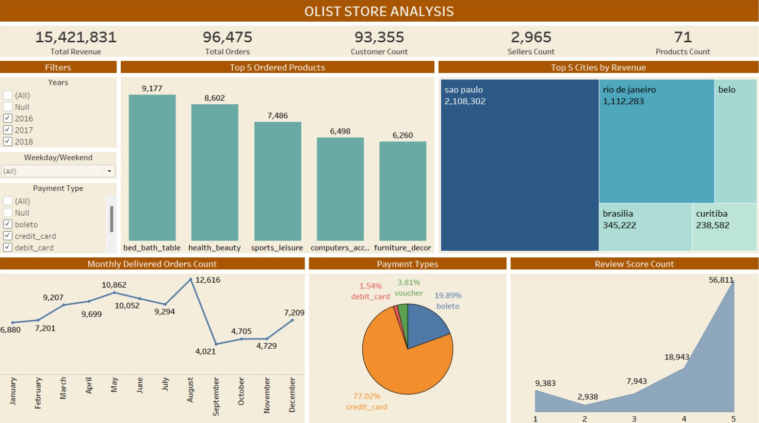

Slide 15
CONCLUSION
Throughout this analysis, we navigated diverse datasets to uncover critical insights into customer behaviors and operational efficiencies.
We identified distinct purchasing patterns during weekdays versus weekends, emphasizing the importance of tailoring sales strategies accordingly.
Our deep dive into regional preferences, especially in Sao Paulo city, highlighted the significance of location-based targeting. The study also revealed a compelling connection between shipping efficiency and customer satisfaction.
These findings, integrated from various tools underscore the importance of data-driven decision-making in enhancing customer experiences and streamlining operations.
Armed with these insights, businesses are well-positioned to cater more effectively to their clientele and optimize their market strategies.

